Slide 1

+
-
+

Slide 2
(Republican Party)
-
+
(You)
-
(Rush Limbaugh)

Slide 3
OX |  | PX |  | PO
+ | * | + | = | +
- | * | + | = | -
+ | * | - | = | -
- | * | - | = | +

Slide 4
Key result
Cartwright and Harary (1956) proved that:
  If all of the triads in a signed value matrix are balanced, then:
    The matrix can be blocked into two mutually exclusive groups such that:
    1) All edges with positive weights are within blocks
    2) All edges with negative weights are between blocks.
  Formalizes a key intuition between balance processes at the micro-level and macro-level group structure.

Slide 5


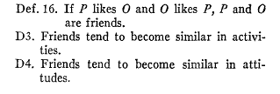

Slide 6

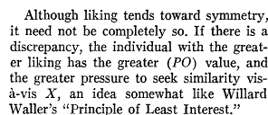

Slide 7

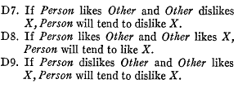

Slide 8

?

Slide 9
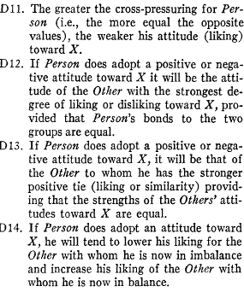

Slide 10
Faust (2007) Sociological Methodology
Since triads concern relations among social actors, most often they are studied using a social network formalization. Indeed, triads have been at the heart of theoretical and methodological advances in social network research for nearly half a century. Triads are implicated in many social network theories…

Slide 11
Faust (2007) Sociological Methodology
As introduced in papers by Davis (1970, 1977, 1979) andHolland and Leinhardt (1970, 1971, 1972, 1973, 1976, 1979), and elaborated in the work of Johnsen (1985, 1986, 1989a, 1989b, 1998), specific global structural patterns imply the presence and absence of specific triadic configurations, just as the occurrence and nonoccurrence of specific triadic patterns imply specific global structural configurations.

Slide 12
Faust (2007) Sociological Methodology
Thus, the triad census is useful for evaluating theories about linkage between local processes and global structures because some theoretical global structures are contradicted by specific configurations of triads. Such a global theory is evaluated by examining empirical networks for substantial occurrence of triads inconsistent with the theory.

Slide 13
Faust (2007) Sociological Methodology
How much of the triadic structure is accounted for by nodal and dyadic properties? This paper provides an answer to that question and shows that more than 90% of the triadic structure in a collection of diverse social networks is accounted for by lower-order properties. The implications of this result are far-reaching. If a substantial portion of triadic structure is explained by nodal and dyadic features, then the theoretical and methodological importance of triadic properties and processes are brought into question.

Slide 15
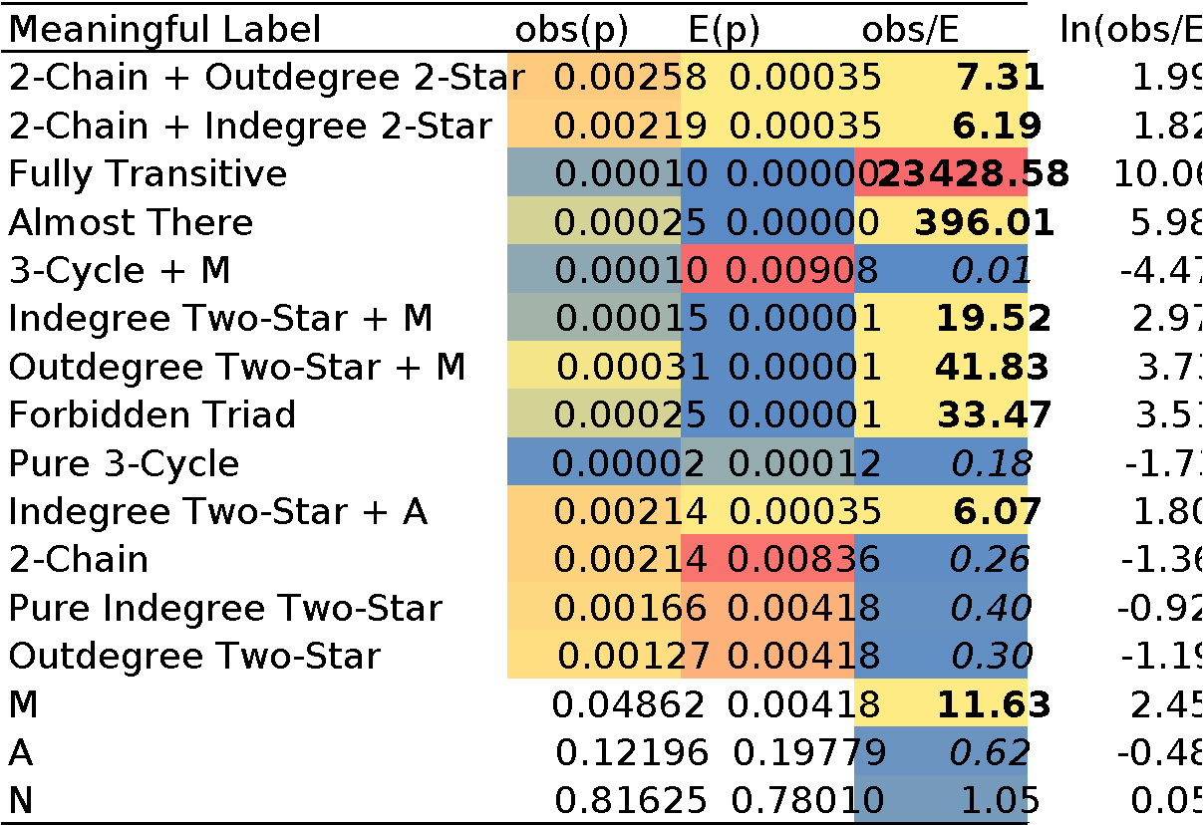

Slide 18





Slide 19
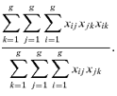

Slide 20
From Bonacich and Lloyd (2004)

Slide 21
Another reason why SVD is your friend
Proposition 1
The eigenvector of a balanced symmetric matrix of affective relations reveals the clique structure.

